Slide 1

Sign What You Really Care About - $ecure BGP AS Paths Efficiently
Yang Xiang Zhiliang Wang
Jianping Wu Xingang Shi Xia Yin
Tsinghua University, Beijing

Slide 2
Outline
Introduction
Backgrounds
Related works: S-BGP, …
Our proposal: FS-BGP
FS-BGP: Fast Secure BGP
Evaluation

Slide 3

IP Prefix Hijacking
Routing info. in BGP can not be verified
Manipulator can drop / intercept / tamper the traffic
Mis-configurations
2008, Pakistan Telecom hijacked YouTube
2010, China Telecom hijacked ~10% Internet
Malicious attacks: spammers, ...
AS4 hijacks prefix f

Slide 4
Solutions
Short-term: detection & mitigation
Analyze anomalies in BGP routing UPDATEs
Listen & Whisper, PGBGP, …
Cons: can not grantee correctness and realtime
Long-term: prevention (our paper)
Adopted by IETF
Cryptographic authentication of routing info.
S-BGP, IRV, soBGP, SPV, S-A, …
Cons: high security v.s. low cost, can’t have both

Slide 5
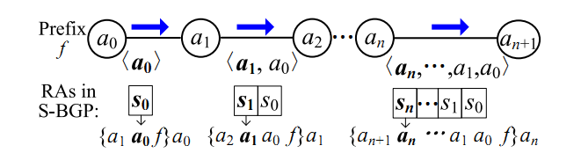
S-BGP
The most secure scheme
Route Attestations (RAs) secure AS paths
Every RA signs prefix and the whole AS path
Includes the recipient AS
<a_{i} , … , a₀>: an AS path
{msg}a_{i} : a signature on msg signed by AS a_{i}

Slide 6
Problems faced by S-BGP
S-BGP signs the whole AS path
There are so many AS paths in the Internet
Unbearable computational cost ...
S-BGP uses expiration-date to defend against replay attack
Long: unable to defend against replay attack
Short: destroy the whole BGP system
Dilemma of expiration-date...

Slide 7
Substitutes for S-BGP
soBGP
Unavailable paths
IRV
Query latency
Hard to maintain authority server
SPV
Complex state info.
Probabilistically guarantee
S-A
Only for signing
Need to pre-establish neighbor list
Security
Efficiency

Slide 8
Our Proposal FS-BGP: Fast Secure BGP
How to secure the AS path
CSA (Critical Segment Attestation) to secure the AS path
SPP (Suppressed Path Padding) to defend against replay attack
Security level
All the authenticated AS paths are available paths
Achieves same level of security as S-BGP
Computational cost (on busy backbone router)
Singing cost: ~0.6% of S-BGP
Verification cost: ~3.9% of S-BGP

Slide 9
Outline
Introduction
FS-BGP: Fast Secure BGP
CSA: Critical Segment Attestation
SPP: Suppressed Path Padding
Evaluation

Slide 10
Announcement Restrictions in BGP
Only announce best routes
According to the Local Preference, etc …
Temporary restriction
Selectively import & export routes (policy)
Available path: exists in the AS graph & obey the policies
Persistent restriction
Neighbor based import & export
Contracts $$ are between neighbor ASes

Slide 11

Critical Path Segment - network operators really care
In an announced AS path: p_{n} = <a_{n+1} , a_{n} , …, a₀>
Critical path segments: c_{n} , … , c₁ , c₀
Critical path segment c_{i} is owned by AS a_{i}
Those adjacent AS triples actually describe the import & export policies
c_{i} = < a_{i+1} , a_{i} , a_{i-1} > means a_{i} will announce routes to a_{i+1} which are import from a_{i-1}

Slide 12
If every AS signs its critical segment in a path, The whole path will become verifiable We call the signature: CSA -- Critical Segment Attestation
Sign What You Really Care About

Slide 13
{msg}a_{i}：signature of msg signed by a_{i}
FS-BGP：CSA
{a₄ a₃ a₂}a₃
√
{a₃ a₂ a₁}a₂
√
√
{a₂ a₁ a₀}a₁
√
√
√
{a₁ a₀ f}a₀
√
√
√
√
〈a₀〉
〈a₁ a₀〉
〈a₂ a₁ a₀〉
〈a₃ a₂ a₁ a₀〉
a₀
a₁
a₂
a₃
a₄
{a₁ a₀ f}a₀
√
√
√
√
{a₂ a₁ a₀ f}a₁
√
√
√
{a₃ a₂ a₁ a₀ f}a₂
√
√
S-BGP：RA
{a₄ a₃ a₂ a₁ a₀ f}a₃
√

Slide 14
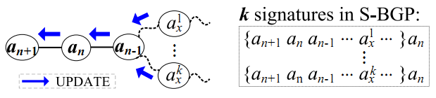
Efficient !
(# total critical segment) << (# total AS path)
Even using a small cache, the cost can be sharply decreased
S-BGP: a_{n} receives k paths, signs k signatures
FS-BGP: a_{n} receives k paths, signs 1 signature

Slide 15
Outline
Introduction
FS-BGP: Fast Secure BGP
CSA: Critical Segment Attestation
SPP: Suppressed Path Padding
Evaluation

Slide 16
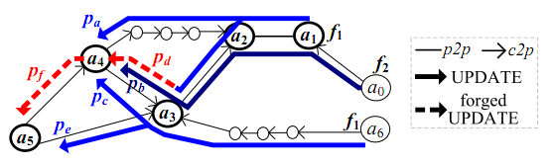
Forge a path in FS-BGP is possible
Using authenticated path segments, manipulator can construct forged path
Forged path in FS-BGP: available, but currently not announced [theorem 1].
a₄ constructs path p_{f} , and hijacks prefix f

Slide 17
Fortunately, life is hard to the attacker
Forge a path in FS-BGP is very difficult
Must be constructed using received & authenticated critical path segments
Must not be announced by the intermediate ASes
Forged path is still available, and only temporarily not announced
Only short enough forge-path can be used for an effective hijacking [Theorem 2]
Forged path can not be shorter than 4 AS hops

Slide 18
SPP: Suppressed Path Padding
Based on AS Path Pre-pending
SPP guarantees
Paths with lower preference (suppressed path) are not shorter than the corresponding optimal path
{a₄, a₃, a₂}a₃
{a₄, a₃, 3, a₂}a₃
p_{f}=<a₅, a₄, a₃, a₃, a₃, a₂, a₁>

Slide 19
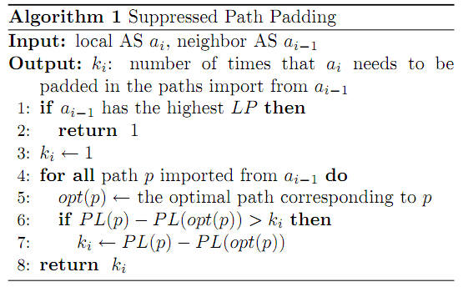
SPP: Suppressed Path Padding
General
Easy to Implement
Light-weight
Optional
Defend against replay attack
Optimal path always has the shortest length
Optimal path always has the longest live-time
Replay attack becomes very hard

Slide 20
Outline
Introduction
FS-BGP: Fast Secure BGP
Evaluation
Security Level
Computational Cost

Slide 21

CSA achieves Available Path Authentication
Paths can be verified in FS-BGP are all available paths
Signed paths
in S-BGP
Signed paths
in FS-BGP
All available
paths
1. Outdated path
2. Current path
1. Outdated path
2. Current path
3. Revealed path
1. Outdated path
2. Current path
3. Revealed path
4. Potential path

Slide 22
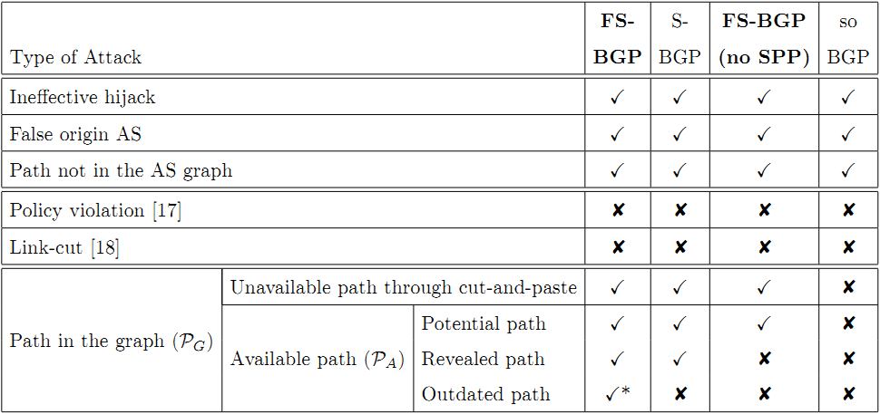
Security Level

Slide 23
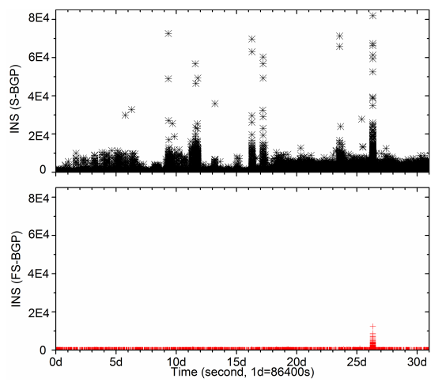
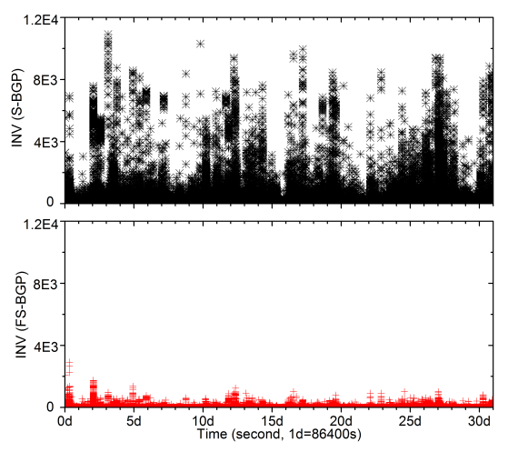
Computational Cost
30 days’ real BGP UPDATEs (backbone)
Cost reduced by two orders of magnitude
Achieves real-time signing & verification
S-BGP
S-BGP
FS-BGP
FS-BGP
# signings in every second
# verifications in every second

Slide 24
Conclusion
Thanks!
FS-BGP: Fast Secure BGP
CSA: Critical Segment Attestation
SPP: Suppressed Path Padding
Evaluation
Similar security level as S-BGP
Reduced the cost by orders of magnitude
Future work
More efficient caching
Implementation, standardization …

Slide 25
backup

Slide 26
Outline
Discussion
Support complex routing policies
Protect privacy

Slide 27
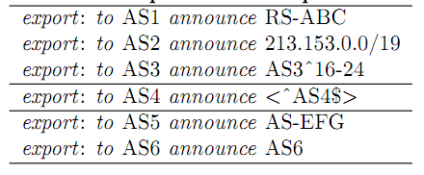
Handle complex routing policies
AS may use complicate route filters to describe their routing policies
Prefix filter：
Path filter：
Origin filter：
FS-BGP can be flexibly extended and support route filters
← Included feasible prefixes into CSA
← Sign whole path
← Included feasible origins into CSA

Slide 28
Revisit the route filters
Quantity of route filter
According our statistical result in IRR database, only a very small portion of policies use route filters
Purpose of route filter
Some (i.e., origin/path filter) are set for security considerations, rather than policy requirements.
Others (i.e., prefix filter) are set for traffic engineering, to identifying the preference of a route, rather than the availability of a path

Slide 29
Privacy Protection
Privacy: customer list …
FS-BGP does not make things worse!
NO additional information
Information spreading manner is same as BGP
Info. is only passively received by valid BGP UPDATE receivers
NO public policy database

